Slide 1
Supervised Ranking of Linguistic Configurations
Targeting Sentiment
Jason Kessler
Indiana University
Nicolas Nicolov
J.D. Power and Associates,
McGraw Hill

Slide 2
Sentiment Analysis
“While the dealership was easy to find and the salesman was friendly, the car I bought turned out to be a disappointment.”
Bag of words:
  Two positive terms, one negative term
  Conclusion: author likes the car
Notes:
Darkened the green a bit (it was too light and difficult to distinguish from white); Underlined the sentiment phrases.

Slide 3
What if we knew the sentiment targets?
“While the dealership was easy to find and the salesman was friendly, the car I bought turned out to be a disappointment.”
Notes:
Modified the arrows. Darkened the green of the sentiment expressions.

Slide 4
Outline
Sentiment expressions
Finding sentiment targets
Previous work
Our approach: supervised ranking
Evaluation

Slide 5
Sentiment Expressions
Single or multi-word phrases
  Express evaluation
Contextual polarity
  I like the car (positive)
  It is a lemon (negative)
  The camera is not small (negative)
Assume annotation of sentiment expressions, their polarity

Slide 6
Targets
Target = word or phrase which is the object of evaluation
Sentiment expressions only link to physical targets:
☒ Bill likes to drive.
☑ Bill likes to drive the car.
Multiple targets possible:
  — Bill likes the car and the bike.

Slide 7
Targets (2)
Some mentions are not targets.
  Sue likes₁ Al’s car₁.
Tricky cases:
  The car₂ frightens₂ Mary.
  Mary₄’s dislike₃ of Bill’s car₃ is a turn-off₄ for him.
  Look at those pancakes₅. My mouth is watering₅.

Slide 8
Problem
Given annotation of mentions and sentiment expressions
Identify targets of all sentiment expressions

Slide 9
Manual Annotations
Entity-level sentiment: Positive
John recently purchased a
digital camera.
PERSON
CAMERA
TARGET
TARGET
TARGET
COREF
It
had a
great
zoom lens,
a
mildly
disappointing
flash,
CAMERA
CAMERA-PART
CAMERA-PART
PART-OF
PART-OF
Entity-level sentiment: Mixed
TARGET
LESS
and was
very
compact.
He also considered a
Cannon
PERSON
CAMERA
FEATURE-OF
TARGET
MORE
which,
while
priced
highly
had a
better
flash.
CAMERA-FEATURE
CAMERA-PART
DIMENSION

Slide 10
Other Annotations
Sentiment expressions
Intensifiers, negators, neutralizers, committers
Targets, opinion holders
Mentions and semantic types
Coreference, part-of, feature-of, instance-of
Entity-level sentiment
Comparisons and their arguments
Notes:
Neutralizers: It should be X, It sounds like X, Committers: I’m pretty sure that X, It would be reasonable to say that X,

Slide 11
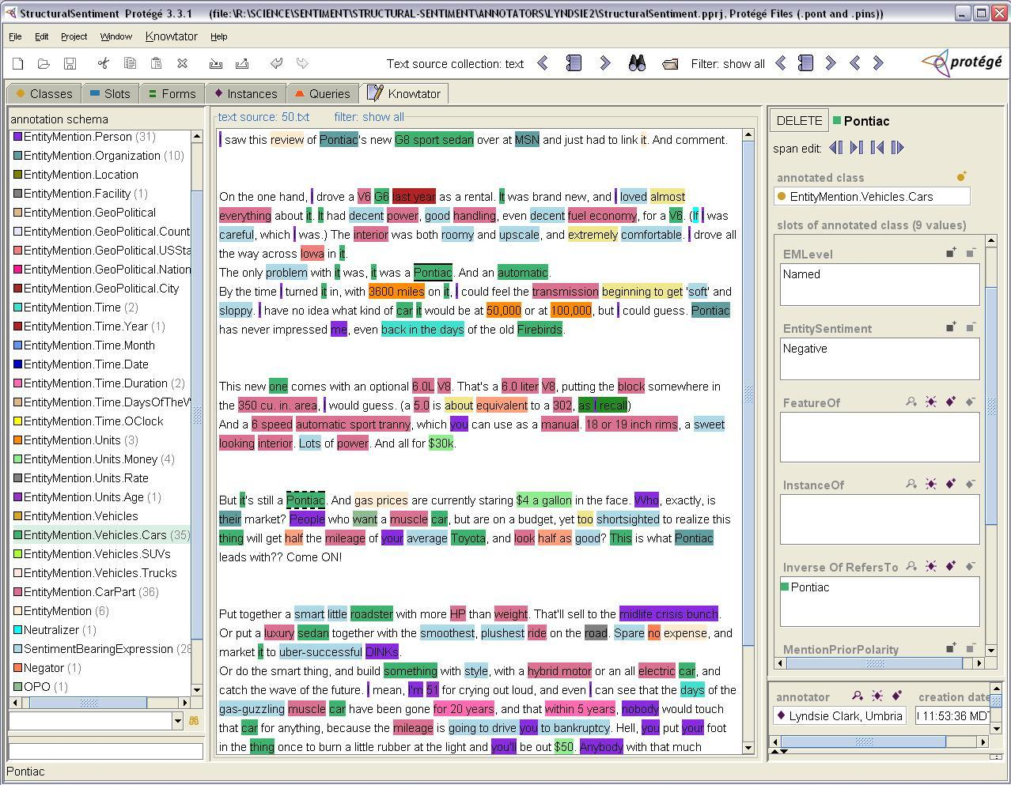

Slide 12
Corpus Size/Statistics
Micro-averaged harmonic mean of precision between annotator pairs
Sentiment expressions: 76.84
Mentions: 87.19
Targets: 81.55
Domain | Docs | Tokens | Sentences | Sentiment Expressions | Mentions
Cars | 111 | 80,560 | 4,496 | 3,353 | 16,953
Camera | 69 | 38,441 | 2,218 | 1,527 | 9,446
Total | 180 | 119,001 | 6,614 | 4,880 | 26,399
Notes:
Add the formula. Say verbally “micro-averaged harmonic mean …”

Slide 13
Baseline - Proximity
Proximity approach:
  Nearest mention selected as target
  Break ties by preferring right-hand mention
  Breaks on: Sue likes₁ Al’s car₁.
Notes:
Increased the size of the arrows. Picked a lighter blue.

Slide 14
Baseline – One Hop
Run a dependency parser
  Mentions that govern or are governed by SE
  Use Stanford dependency parser
  Partially breaks on:
DOBJ
Sue
likes₁
Al’s
car₁.
NSUBJ
POSS
M. de Marneffe, B. MacCartney & C. Manning.
2006. “Generating typed dependency parses from
phrase structure parses”. LREC 2006.

Slide 15
Previous Work – Decision List
Decision list of dependency paths:
  Ordered list of 41 labeled dependency paths between sentiment expression and mention
  Top path connecting a sentiment expression to a mention → mention is the target
…
4. SE –DOBJ→ Mention
5. SE –NSUBJ→ Mention
…
DOBJ
DOBJ
Sue
likes₁
Al’s
car.
It₁
upset₁
Amy.
Sample list slice
NSUBJ
POSS
NSUBJ
Kenneth Bloom, Navendu Garg & Shlomo Argamon. 2007. “Extracting Appraisal Expressions”. NAACL-HTL 2007.

Slide 16
Our Approach
Learning to target from a corpus:
  Bill likes₁ the car₁ and Sarah knows it.
  Classification:
    Three independent binary classifier calls
    features(like, car) =? Target/Not Target
    features(like, Bill) =? Target/Not Target
    features(like, Sarah) =? Target/Not Target

Slide 17
Our Approach
Supervised Ranking
  Bill likes₁ the car₁ and Sarah knows it.
  Rank Bill, car, and Sarah by likelihood of being a target of like
    Ensure car is ranked the highest
  Learn score function s to appx. rank:
    Input: features relating sentiment expression, mention
    Output: number that reflects rankings
    s(features(like, car)) < s(features(like, Bill))
    s(features(like, car)) < s(features(like, Sarah))
Notes:
Learn a score function that, given a sentiment expression and a mention, returns a high score if the mention is its target.

Slide 18
Our Approach
Learn score function given ranks:
  Given:
    My car gets good₁ gas milage₁.
      Ranks for good: gas mileage: 0, car: 1, my: 1,
    It handles₂ well₂.
      Ranks for well: handles: 0, it: 1
  For score function s ensure that:
    s(features(good, gas mileage)) < s(features(good, car))
    s(features(good, gas mileage)) < s(features(good, my))
    s(features(well, handles)) < s(features(well, it))
  Ensure difference ≥ 1

Slide 19
Our Approach
Use RankSVM to perform supervised ranking
Features
  Incorporate syntax (dependency parse)
  Extract labeled-dependency paths between mentions and sentiment expressions
Joachims, T. 2002. Optimizing search engines using clickthrough data. KDD.

Slide 20
Features
AUX
DOBJ
Paul
likes₁
to
drive
the
blue car₁
NSUBJ
DET
XCOMP
Feature: likes ↔ blue car | Example
# tokens distance | 3
# sentiment expressions between | 0
# mentions between | 0
Lexical path | to drive the
Lexical stem path | to drive the
POS path | ⟨ TO, VBD, DT ⟩
Stem + labeled dep. path | like :: ⟨↓XCOMP, ↓DOBJ ⟩
Labeled dependency path | ⟨↓XCOMP, ↓DOBJ ⟩
Semantic type of mention | Car
POS tags of s.exp., mention | ⟨ VBP, NN ⟩
Encoded as binary features

Slide 21
Results – All parts-of-speech
10 fold cross validation over all data
Notes:
State the difference with human performance.

Slide 22
Results - Verbs
Problem: John likes₁ the car₁ (-dobj) vs.
The car₂ upset₂ me. (-nsubj)

Slide 23
Results - Adjectives
AMOD
Problems:
horrible,
no good,
very bad,
movie.
terrible
DEP

Slide 24
Future work
  Apply techniques to targeting intensifiers, etc.
  Inter-sentential targeting
  Domain adaptation
  Other approaches Kobayashi et al. (2006), Kim and Hovy (2006)
Conclusions
  Proximity works well
  Substantial performance gains from supervised ranking and syntactic and semantic features

Slide 25
Thank you!
Special thanks to:
Prof. Martha Palmer
Prof. Jim Martin
Dr. Miriam Eckert
Steliana Ivanova,
Ron Woodward
Prof. Michael Gasser
Jon Elsas

Slide 26
Dependency Features
DOBJ
AUX
Paul
likes₁
to
drive
the
blue
car₁
NSUBJ
AMOD
DET
XCOMP
Group sentiment expressions/mentions as single node:
AUX
DOBJ
Paul
likes₁
to
drive
the
blue car₁
NSUBJ
DET
XCOMP

Slide 27
Dependency Features
AUX
DOBJ
Paul
likes₁
to
drive
the
blue car₁
NSUBJ
DET
XCOMP
Like, blue car: ↓XCOMP, ↓DOBJ
Great₁
car₁
Great, car: ↑AMOD
AMOD
↓ in front of grammatical relation indicates path is followed
↑ indicates path is followed in opposite direction
Notes:
Say verbally: “Extract typed dependency path between SE and Mention”.
-/+ alternatively use the up/down arrow as you use on a later slide.

Slide 28
Previous Work
Kim & Hovy (2006)
  Use FrameNet-based semantic role labeler on sentences with verb/adjective SEs
  Some frame elements are considered always targeting (e.g. stimulus, problem)
stimulus
experiencer
Bill₂’s
handling₁
of
the
situation₁
annoyed₂
Sam.
agent
problem
S.Kim & E.Hovy. 2006. “Extracting Opinions, Opinion Holders, and Topics Expressed in Online News Media Text”. Sentiment and Subjectivity in Text, ACL 2006.

Slide 29
Previous Work
Kobayashi et al. (2006)
  Corpus based, statistical machine learning approach (Japanese product review corpus)
  Determining winner reducible to binary classification
    Bill likes₁ the eraser₁ and Sarah knows it.
      Produces training data:
        Features(Bill, eraser | like, sentence) -> Right
        Features(eraser, Sarah | like, sentence) -> Left
      To find like’s target
        Winner of Bill vs. eraser competes against Sarah
        Two calls to binary classifier
  What features to use?, can’t have multiple targets
Nozomi Kobayashi, Ryu Iida, Kentaro Inui, and Yuji Matsumoto. 2006. Opinion Mining on the Web by Extracting Subject-Attribute-Value Relations. In AAAI-CAAW 2006.

Slide 30
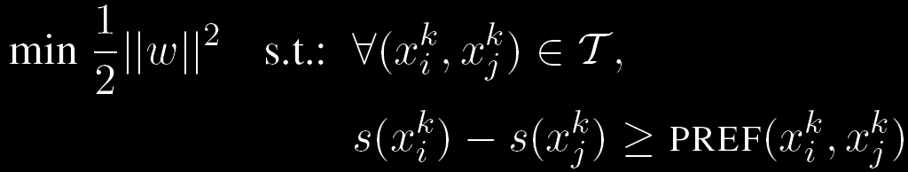
Our Approach
Supervised ranking (RankSVM):
  Training data partitioned into subsets
  Instances x_{i} in each subset (k) are given relative rankings, PREF function give difference in ranking
  Score function s should reflect partial orderings
  We use SVMLight implementation
Joachims, T. 2002. Optimizing search engines using clickthrough data. KDD. (Formulation from Lerman et al. EACL’09)

Slide 31
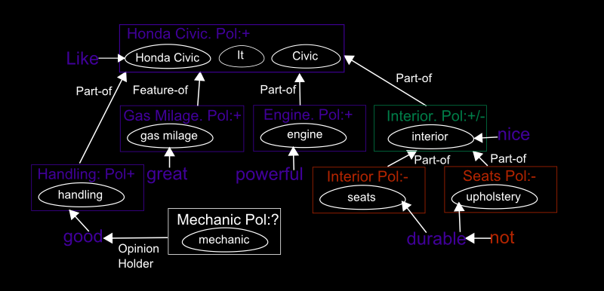
JDPA Sentiment Corpus

