Slide 1
From Sentiment to Persuasion Analysis
Jason Kessler
Data Scientist, CDK Global
@jasonkessler
www.jasonkessler.com

Slide 2
Customer-Written Product Reviews
Good Ad Content

Slide 3
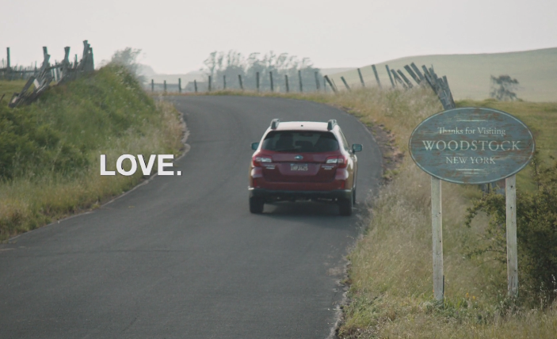
Naïve Approach: Indicators of Positive Sentiment
"If you ask a Subaru owner what they think of their car, more times than not they'll tell you they love it,"
-Alan Bethke, director of marketing communications for Subaru of America (via Adweek)
Notes:
Source: http://www.adweek.com/news/advertising-branding/how-subaru-fell-love-and-never-looked-back-148475
"If you ask a Subaru owner what they think of their car, more times than not they'll tell you they love it," said Alan Bethke, director of marketing communications for Subaru of America. "It was always in front of us, but never utilized in the marketing."

Slide 4
Positive sentiment.
Engaging language.

Slide 5
Finding Engaging Content
# of users who read review:
20
Example Review Appearing on a 3rd Party Automotive Site
Rating: 4.4/5 Stars
Car Reviewed: Chevy Cruze
Text:
…I was very skeptical giving up my truck and buying an "Economy Car." I'm 6' 215lbs, but my new career has me driving a personal vehicle to make sales calls. I am overly impressed with my Cruze…
Notes:
Break up slide

Slide 6

Finding Engaging Content
# of users who read review:
20
Example Review Appearing on a 3rd Party Automotive Site
Rating: 4.4/5 Stars
# who went on to visit a Chevy dealer’s website:
15
Car Reviewed: Chevy Cruze
Text:
…I was very skeptical giving up my truck and buying an "Economy Car." I'm 6' 215lbs, but my new career has me driving a personal vehicle to make sales calls. I am overly impressed with my…
Notes:
Break up slide

Slide 7
Finding Engaging Content
# of users who read review:
20
Example Review Appearing on a 3rd Party Automotive Site
Rating: 4.4/5 Stars
# who went on to visit a Chevy dealer’s website:
15
Car Reviewed: Chevy Cruze
Text:
…I was very skeptical giving up my truck and buying an "Economy Car." I'm 6' 215lbs, but my new career has me driving a personal vehicle to make sales calls. I am overly impressed with my…
Review Engagement Rate:
15/20=75%
Notes:
Break up slide

Slide 8
Finding Engaging Content
# of users who read review:
20
Example Review Appearing on a 3rd Party Automotive Site
Rating: 4.375/5 Stars
# who went on to visit a Chevy dealer’s website:
15
Car Reviewed: Chevy Cruze
Text:
…I was very skeptical giving up my truck and buying an "Economy Car." I'm 6' 215lbs, but my new career has me driving a personal vehicle to make sales calls…
Review Engagement Rate:
15/20=75%
Median Review Engagement Rate:
22%

Slide 9
Notes:
Three and four star reviews may be more credible.

Slide 10
Sentiment vs. Persuasiveness: SUV-Specific
Positive Sentiment | High Engagement
Love | Comfortable
Comfortable | Front [Seats]
Features | Acceleration
Solid | Free [Car Wash, Oil Change]
Amazing | Quiet

Slide 11
Sentiment vs. Persuasiveness: SUV-Specific
Positive Sentiment | High Engagement
Love | Comfortable
Comfortable | Front [Seats]
Features | Acceleration
Solid | Free [Car Wash, Oil Change]
Amazing | Quiet
Negative Sentiment | Low Engagement
Transmission | Money [spend my, save]
Problem | Features
Issue | Dealership
Dealership | Amazing
Times | Build Quality [typically positive]

Slide 12
High Sentiment Terms
Love
Awesome
Fantastic
Handled
Perfect
Notes:
Source: http://www.adweek.com/news/advertising-branding/how-subaru-fell-love-and-never-looked-back-148475

Slide 13
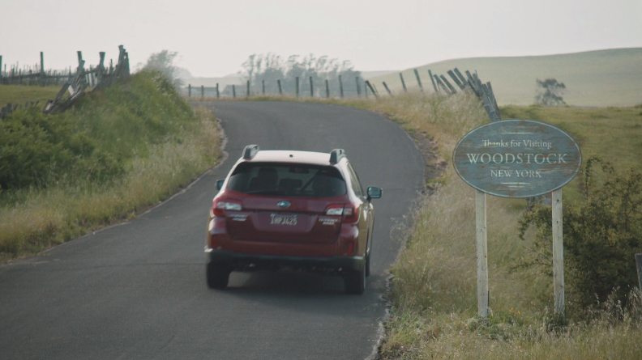
Engagement Terms
Blind (spot, alert)
Contexts from high engagement reviews
“The techno safety features (blind spot, lane alert, etc) are reason for buying car...”
“Side blind Zone Alert is truly wonderful…”
…
Notes:
Edit examples to ensure that blind spot alert system

Slide 14
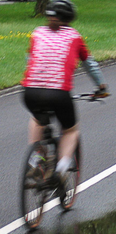
BLIND SPOT ALERT.
Notes:
Source: http://www.adweek.com/news/advertising-branding/how-subaru-fell-love-and-never-looked-back-148475

Slide 15
Can better science improve messaging?
Engagement Terms
Blind
White (paint, diamond)
BLIND SPOT ALERT.
Contexts
“White with cornsilk interior.”
“My wife fell in love with the Equinox in White Diamond”
“The white diamond paint is to die for”

Slide 16
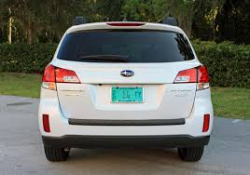
Can better science improve messaging?
BLIND SPOT ALERT.

Slide 17
Can better science improve messaging?
Engagement Terms
Blind
White
Climate (geography, a/c)
BLIND SPOT ALERT.
Contexts
“Love the front wheel drive in this northern Minn. Climate”
“We do live in a cold climate (Ontario)”
…climate control…

Slide 18
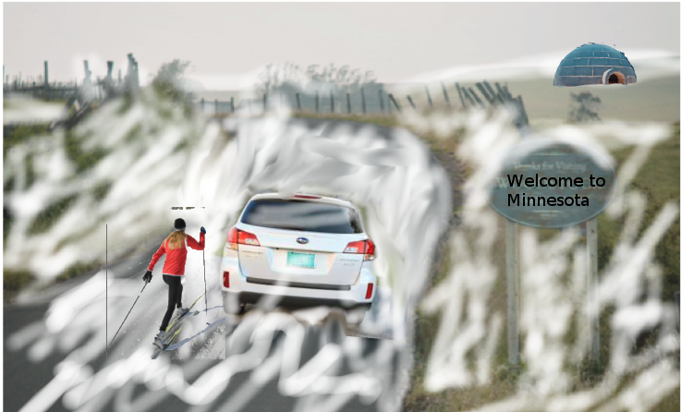
BLIND SPOT ALERT.
Notes:
Excuse the poor photoshopping.

Slide 19
Questions? (Yes, we’re hiring!!)
Head to CDKJobs.com
-or-
talk to me
Find “Jobs by Category”
Click Technology
Have your Resume ready
Click “Apply”!
Data Scientist
UI/UX Development & Design
Software Engineer – all levels
Product Manager
Is this you?

