Slide 1
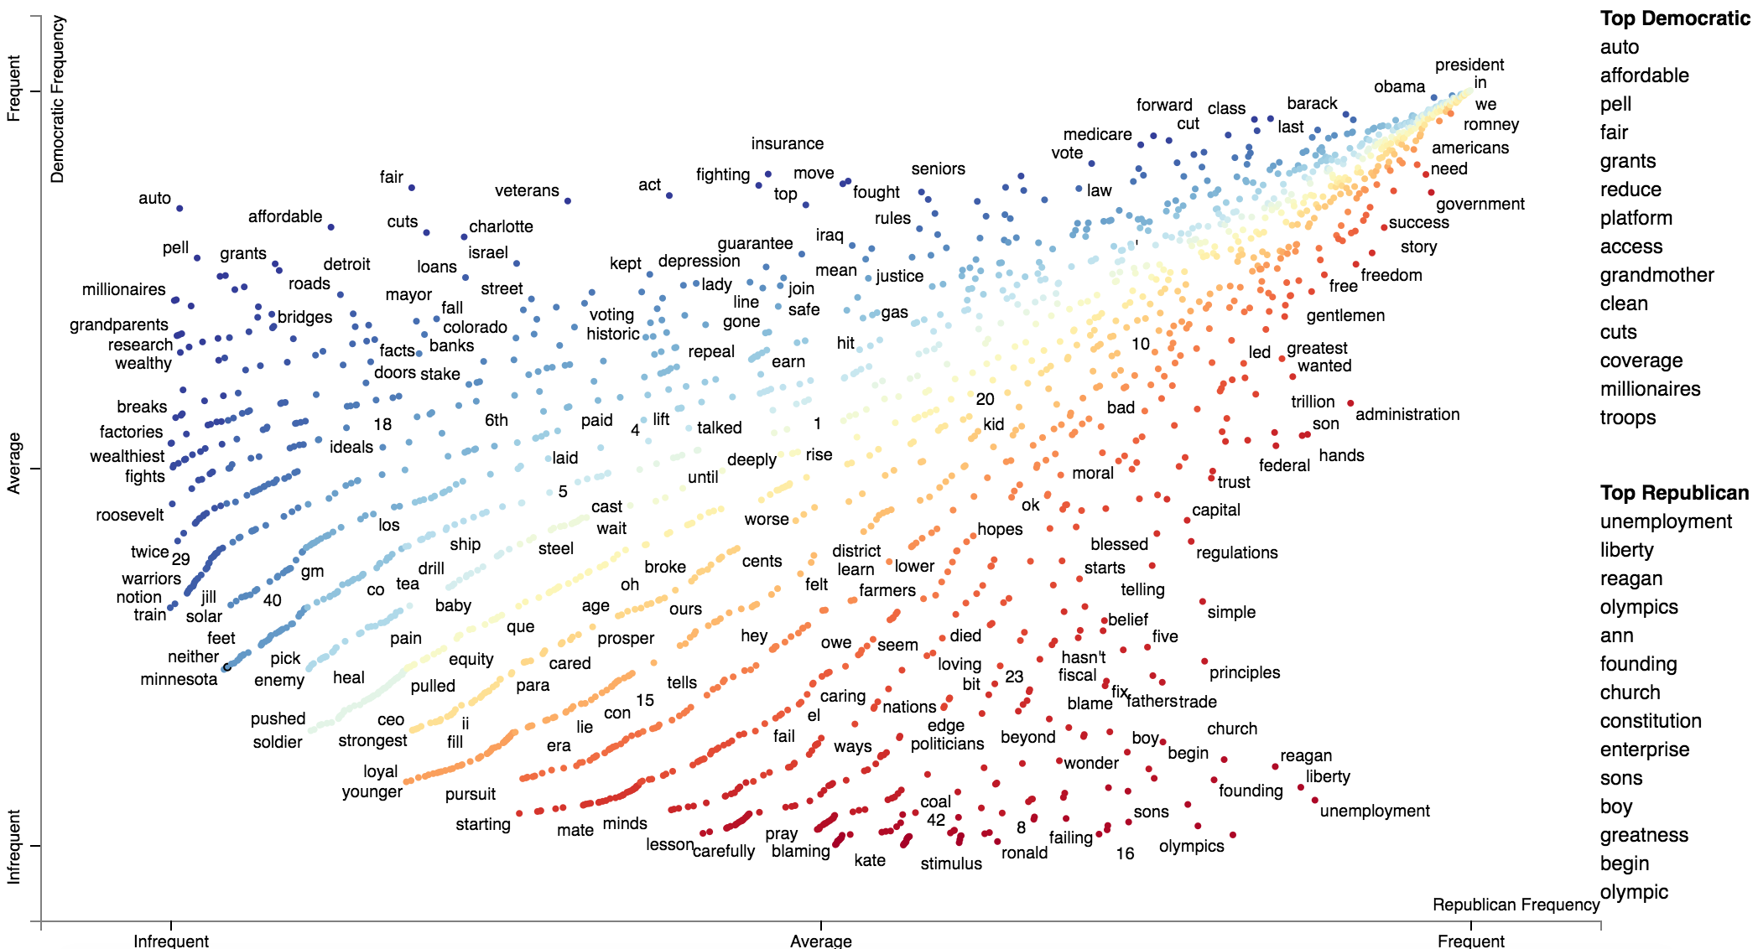
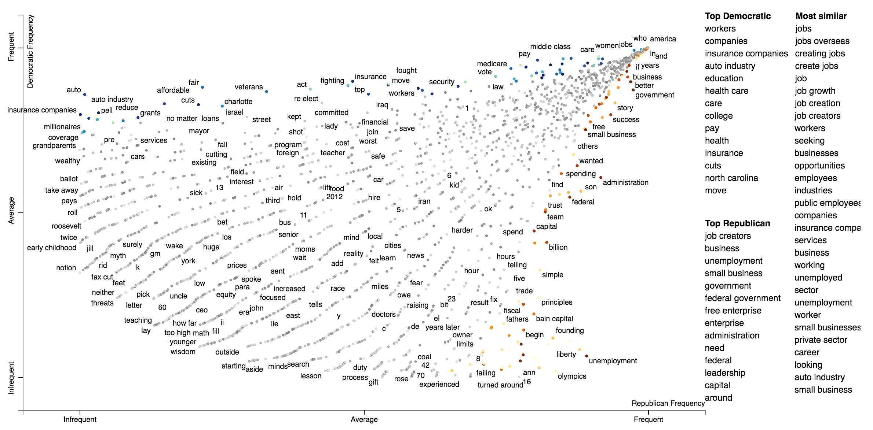
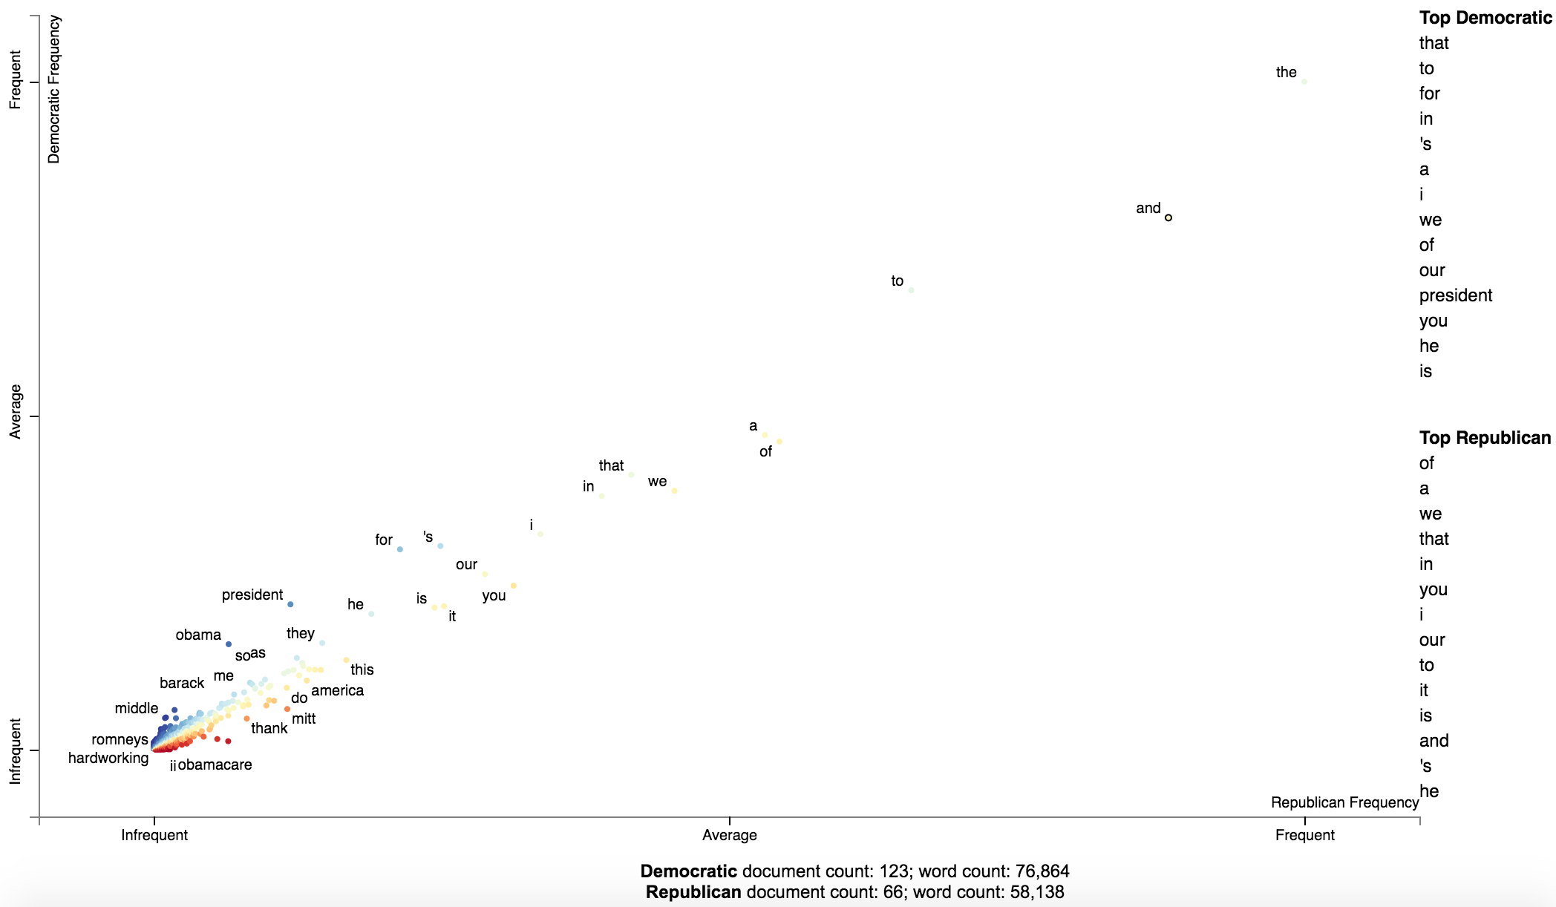
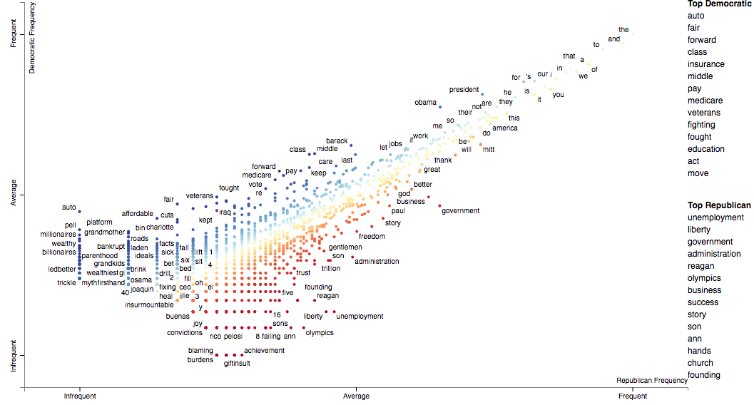
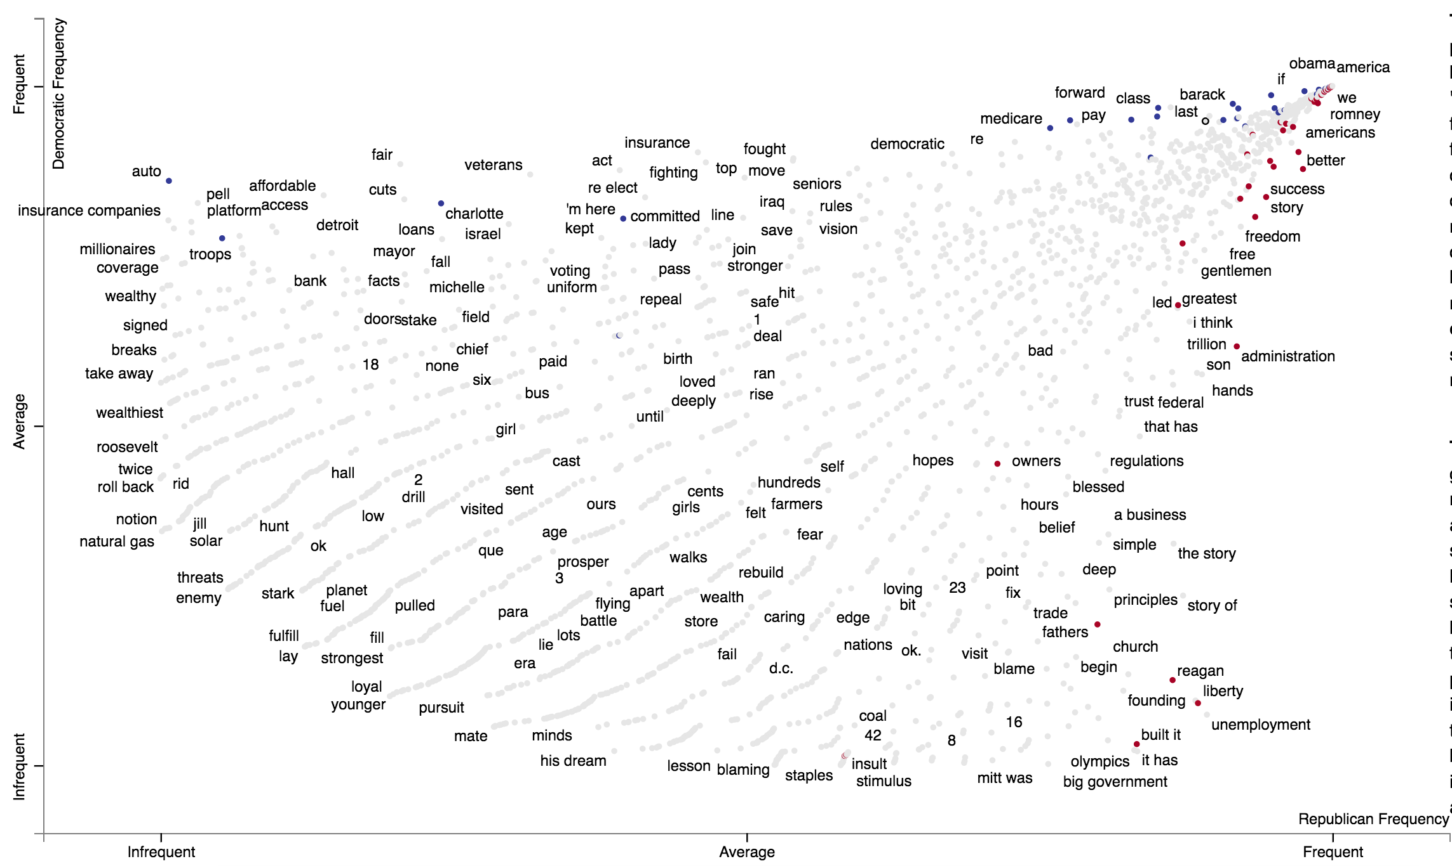
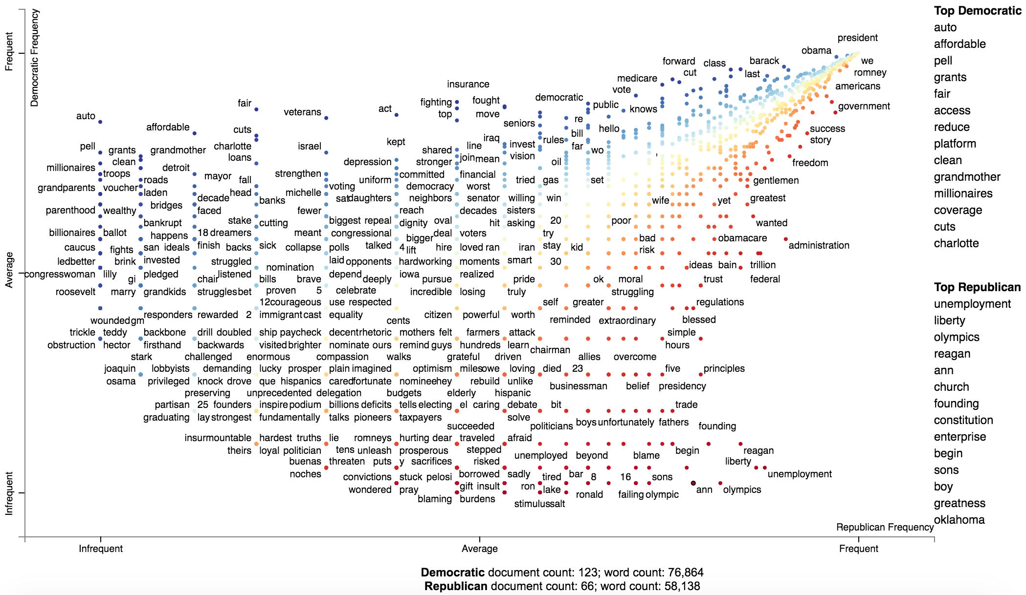
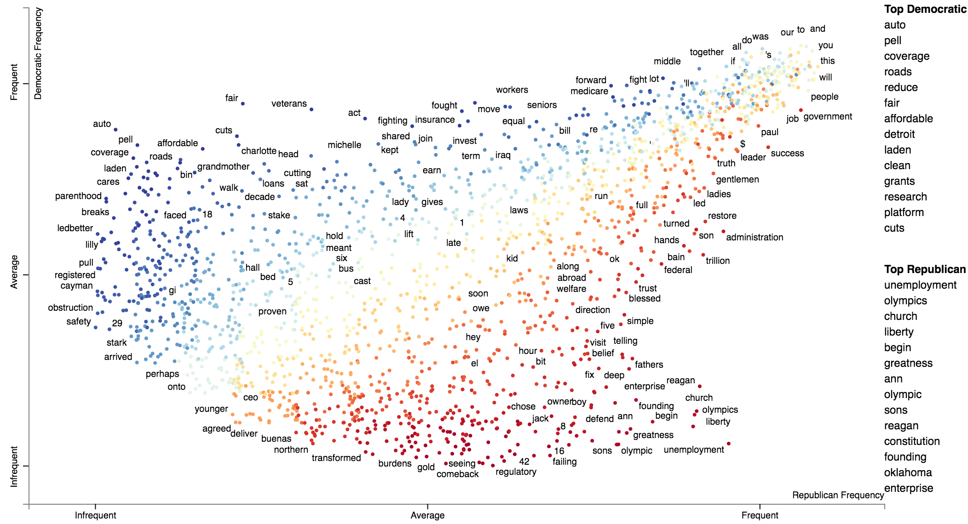
Scattertext: a Browser-Based Tool for Visualizing how Corpora Differ
Jason S. Kessler | CDK Global | @jasonkessler
github.com/JasonKessler/scattertext $pip3 install scattertext
More things Scattertext can do
Dichotomous word embedding visualization
Scattertext can be used to visualize how the same concept is discussed differently in each class.
Below, only words significantly associated with a class are colored.
The intensity of the color is based on the cosine distance of their word vectors to that of “jobs”.
A log-odds ratio with an uninformative prior is used to determine similarity statistical association.
Visualizing sparse log-linear classifier weights
By coloring terms using their L1-penalized logistic regression scores, we can see all the words left out.
Moral: don’t use L1 when looking for broad-coverage interpretable features.
More things Scattertext can do
Visualize emotional categories via Empath
Visualize category-associated Emoji
Visualize other dense scatter plots
Implementations of several term association algorithms
Each point refers to a unigram or bigram. Y-axis: frequency used by Democrats. X-axis: Republicans.
Upper left: terms highly associated with Democrats. Lower right: Republicans
Color also indicates association
Axis position is based on frequency rank, ties are broken alphabetically. Causes diagonal point-strands.
See below for why:
Plot terms based on their class-specific frequency.
Stopwords and whitespace dominate.
Nobody (outside James Pennebaker?) would like this plot.
Log-scaling axes helps a little, but there’s still a lot of whitespace
Scaling by frequency percentiles. Terms stack a top each other
Jittering upsets the term ordering, most visibly in the upper right. Instead

